Slide 1
Computer Networks
Lecture 8
Transmission Control Protocol (TCP)
Notes:
DCCN2 - Lecture 8 - TCP

Slide 2
Introduction
TCP is one of the transport layer protocols of TCP/IP
Error control, flow control and congestion control exist
TCP can be categorized as a reliable protocol
Combination TCP/IP is reliable

Slide 3
TCP Connection Process
TCP-Client and TCP-Server connection process has three phases
- Connection Establishment
- Data Transferring
- Connection Termination

Slide 4
Connection Establishment
Client
Server
SYN
ACK
SYN
TIME
ACK

Slide 5
Three way handshake
Four steps can be reduced to three steps
Client
Server
SYN
SYN, ACK
TIME
ACK

Slide 6
Three way handshake cont.
The SYN, SYN/ACK and ACK are 1-byte messages
After the connection is established, data can be transmitted in full duplex mode between a client and a server

Slide 7
Data Transfer
Client
Server
Data
TCP is a reliable protocol.
TCP sends an Acknowledgement (ACK) for each segment of received data.
ACK
Data
ACK
TIME
Data
ACK

Slide 8
Data Transfer cont.
Piggybacking
Sending Data and ACK together.
Client
Server
Data
TIME
Data, ACK
Data, ACK

Slide 9
Data Transfer cont.
Data is transferred as Segments
Each segment is given an identification called a Sequence Number.
Acknowledgement Number =
Sequence Number (Received) + Number of bytes in the segment

Slide 10
Terminating the connection
Client
Server
FIN
ACK
FIN
ACK
TIME
Normally the connection termination request is initiated by the client
FIN and ACK are considered one-byte messages

Slide 11
Problems related to data transfer
The following three problems must be addressed in data transferring process for a better data transmission
- Error control
- Flow control
- Congestion control

Slide 12
Error Control
TCP receiver uses checksum bits for error detection
If there are no errors it sends an acknowledgement to the sender
If errors are found, the receiver does not send any negative acknowledgement to the sender

Slide 13
Error Control cont.
In this process, the sender and receiver should have the following facilities
- Sender buffer
- Receiver buffer
- Timer
Sender buffer needs to keep the segments, until it receives an acknowledgement from the receiver
Receiver buffer needs to keep the segment, until the error checking is over
The sender needs a timer to check whether the Retransmission Time is expired after sending the segment

Slide 14
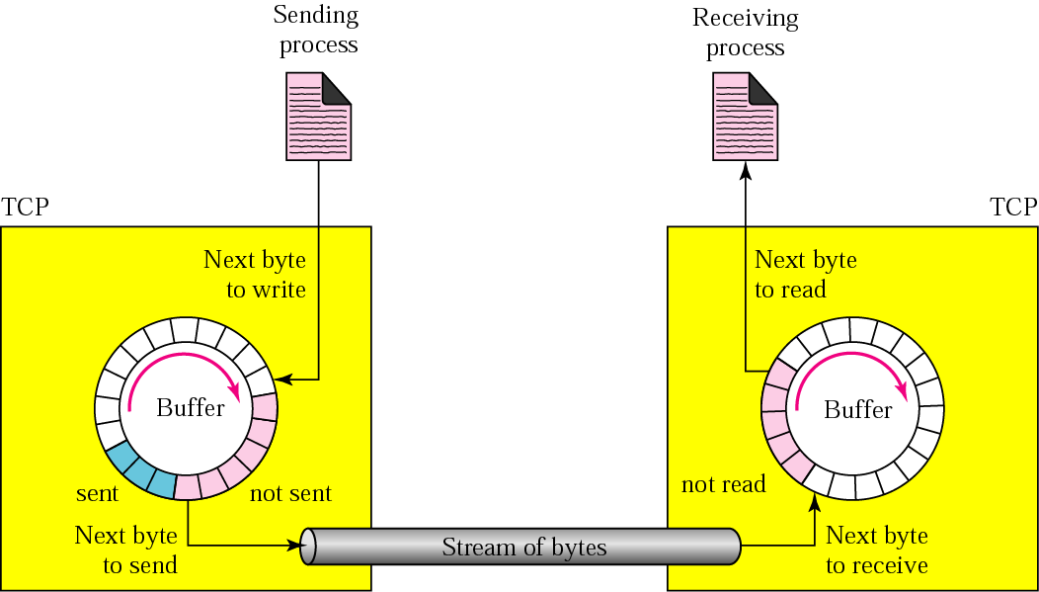
Flow control

Slide 15
Slow Applications
If the application is very slow and it sends 1 byte at a time
Application layer send data to the Tx buffer of the TCP layer
The TCP protocol adds a 20byte TCP header and sends to IP layer
The IP layer adds 20 bytes of IP header and sends data link layer
Data link layer also adds a header and a trailer (say 26 bytes)
Altogether 20+20+26 = 66 byte overhead is added to application data

Slide 16
Slow Applications cont.
1 byte of data is combined with 66 byte overhead bits
This is a very inefficient data transfer
TCP has the facility to improve such a situation by defining the minimum data required for a segment
TCP waits until such an amount of data is collected
After that the TCP segment is sent to the IP layer

Slide 17
Fast application/ Slow network/ Slow receiver
Application layer buffers and TCP layer buffer sizes are decided on the following factors
- Speed of application
- Speed of computer
- Speed of the network
- Congestion of network
If the sender application is faster than the network, it will overflow the TCP buffer and gives a “ runtime error” – PCs Stuck
Needs to Restart

Slide 18
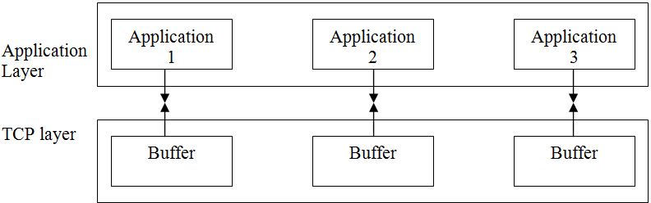
Multiplexing
TCP layer can handle several application processes at the same time
  - E-mail, Web browsing , Transfer files
Port Number identifies the application

Slide 19
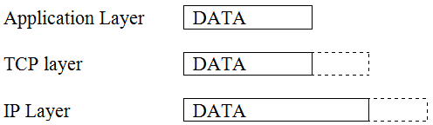
TCP with IP layer
IP layer receives data from the transport layer
Therefore the type of data in IP packet can be TCP, UDP.
Each type of data is given a unique protocol number

Slide 20
Port number
The port number is a 16 bit binary number in the TCP
It is in the range of 0-65535
The port numbers are divided into three ranges.
- Well known ports
- Registered ports
- Dynamic ports/ Ephemeral ports

Slide 21
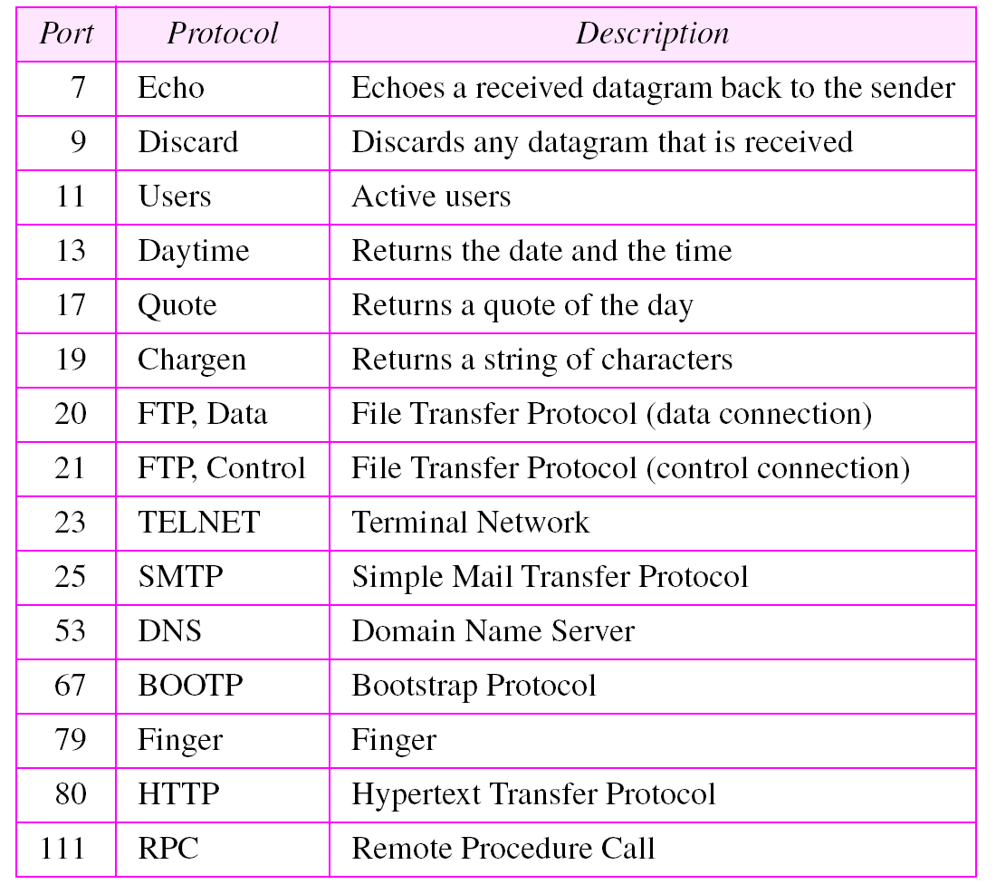
Well-known ports
Port numbers ranging from 0-1023 is called well-known ports
Assigned for Standard Server Processes

Slide 22
Registered ports
The ports ranging from 1024 - 49,151 are to be registered with IANA to prevent duplicating
Used for proprietary server processors or any client process
Normally not used

Slide 23
Dynamic ports
The ports numbers from 49,152 to 65,535 are dynamic or ephemeral ports
They are used by client processes temporarily

Slide 24
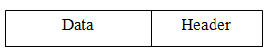
TCP segment
TCP segment consists of data and TCP header
The standard TCP header length is 20 bytes
With the option fields it can be expanded up to 60 bytes

Slide 25
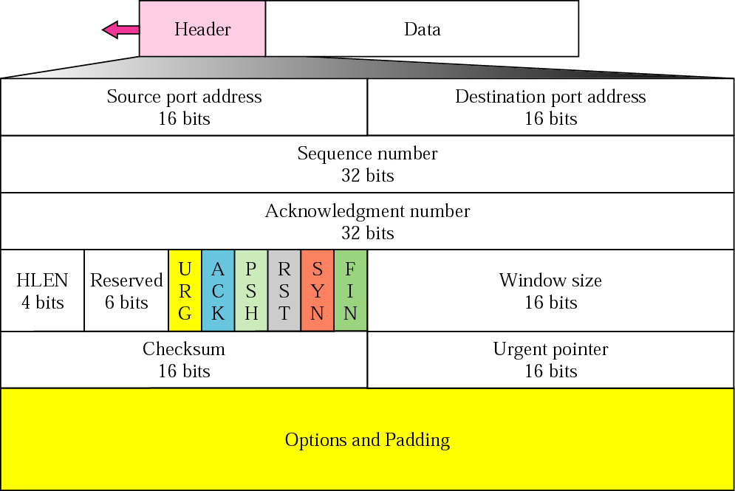
TCP Header

Slide 26
TCP header cont.
Source port address
A 16-bit field
Port number range = 0 – 65535
For client TCP header this is a dynamic port number
For server TCP header this is a well-known port number
Destination port address
Is the destination process port number
A 16-bit field

Slide 27
Sequence number
A 32-bit field
At the time of establishing TCP connection the first sequence number should be decided
Initial Sequence Number (ISN)
It can be any arbitrarily number between 0 and 2³²-1.

Slide 28
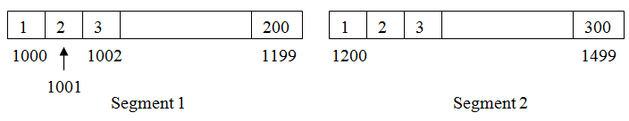
Sequence number cont.
The allocation of sequence number uses the following process
- Suppose the first data segment has 200 bytes
- Second data segment has 300 bytes
- Sequence number of first segment (ISN) is 1000

Slide 29
Sequence numbers of three-way handshake
Client
Server
SYN
ISN = 1000
SYN, ACK
ISN = 5000
TIME
ACK
SN = 1001
SYN and ACK : 1 byte each

Slide 30
Sequence numbers of data segments
Client
Server
Data=200 bytes
SN = 1002
Data=400 bytes
SN = 1202
TIME
Data=200 bytes
SN = 1602

Slide 31
Sequence numbers of data segments cont.
Client
Server
SN=1002
Data=200 bytes
SN=5001
Data=210 bytes
SN=1202
Data=400 bytes
TIME
SN=5211
Data=390 bytes
SN = 1602
Data=200 bytes
SN=5601
Data=400 bytes

Slide 32
Sequence numbers of connection termination
Client
Server
FIN
SN = 1802
ACK
SN = 6001
FIN
SN = 6002
TIME
ACK
SN = 1803
FIN and ACK : 1 byte each

Slide 33
Acknowledgement Number
A 32-bit field
An acknowledgement number is sent by the receiver for each data segment it receives
It is the next sequence number expected by the receiver

Slide 34
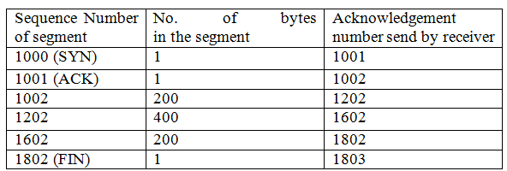
Acknowledgement Number cont.
Relationship among sequence number, number of bytes in a segment and the acknowledgement number sent by the receiver

Slide 35
Acknowledgement numbers of three-way handshake
Server
Client
SYN
ISN = 1000
SYN, ACK
AN = 1001
ISN = 5000
TIME
ACK
SN = 1001
AN = 5001
SYN and ACK : 1 byte each

Slide 36
Acknowledgement numbers of data segments cont.
SN=1002
Client
Server
AN=5001
Data=200 bytes
SN=5001
AN=1202
Data=210 bytes
AN=5211
SN=1202
Data=400 bytes
AN=1602
TIME
SN=5211
Data=390 bytes
SN = 1602
AN=5601
Data=200 bytes
SN=5601
AN=1802
Data=400 bytes

Slide 37
Acknowledgement numbers of data segments cont.
SN=1002
Client
Server
AN=5001
Data=200 bytes
SN=1202
AN=5001
AN=1202
Data=400 bytes
SN = 1602
AN=5001
Data=200 bytes
TIME
SN=5001
Data=210 bytes
AN=1802
SN=5211
Data=390 bytes

Slide 38
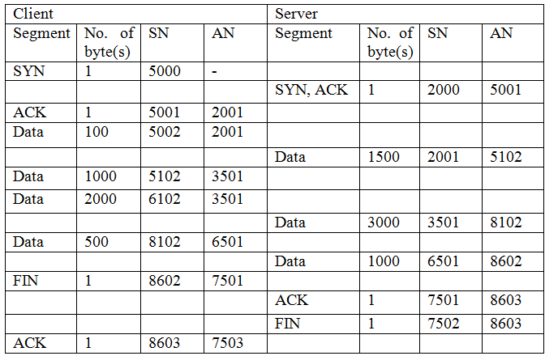
SN and AN in Segment transfer

Slide 39
TCP Header

Slide 40
Header Length (HLEN)
This is a 4-bit field
Header length in bytes = HLEN x 4
The standard size of header is 20 bytes
The maximum size of header is 60 bytes
(20 standard bytes and 40 optional bytes)

Slide 41
TCP Header

Slide 42
Reserved
This 6 bit field reserved for future use

Slide 43
TCP Header

Slide 44
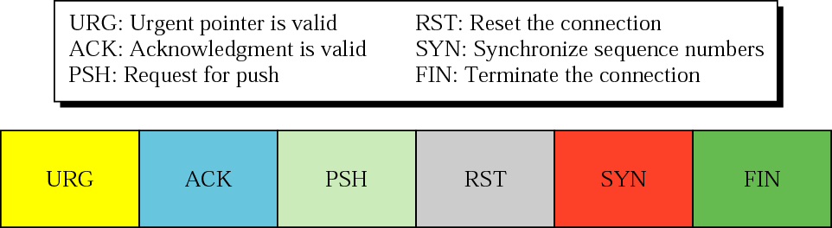
Control
This is also a six bit field

Slide 45
URG - Urgent
Normally receiver reads segments according to ascending order
If this flag is set, that segment should be read immediately

Slide 46
ACK - Acknowledgement
If data is not available in the segment,
then this is an ACK segment
If data is available in the segment,
and if the acknowledgement number is ‘n’’
it indicates that data bytes up to byte n-1 is OK and waiting for sequence number n

Slide 47
PSH - Push
If push flag is set, it does not care about the window size recommended by other party and start the data transmission to the other party

Slide 48
RST - Reset
The connection must be reset ( Destroy / Terminate )
This can happen due to three reasons
  Request for an unidentified port
  Client or server has a problem
  The other side TCP is idle for a long time

Slide 49
RST - Reset cont.
Reason 1 :
The client requests a connection for server to an unidentified port
In such situation server send RST to client to destroy the connection

Slide 50
RST - Reset cont.
Reason 2 :
The connection has been established
After some time the client or server has a problem and request the other party to destroy the connection
Then it (client or server) sends RST to other party.

Slide 51
RST - Reset cont.
Reason 3 :
The other side TCP is idle for a long time
Then RST is sent to the other party to destroy the connection

Slide 52
SYN - Synchronize
Synchronize to sequence numbers (Initial Sequence Number) suggested at the time of connection establishment

Slide 53
FIN - Finish
Request to terminate the connection to that direction
If client sent FIN (that is set FIN flag) to server,
it means that client request from server to disconnect the connection of client server direction

Slide 54
TCP Header

Slide 55
Window size
This is a 16-bit field
Indicates how many bytes (segment data) can be maintained in the other party

Slide 56
TCP Header

Slide 57
Checksum
This is a 16 bit field
Used to check whether there are any errors

Slide 58
TCP Header

Slide 59
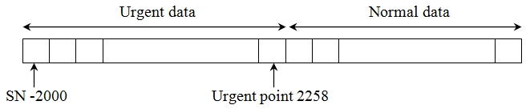
Urgent Pointer
This is a 16-bit field valid only if the urgent flag is set
This value gives the byte value at the end of urgent data
The bytes 2000 to 2258 are urgent data

Slide 60
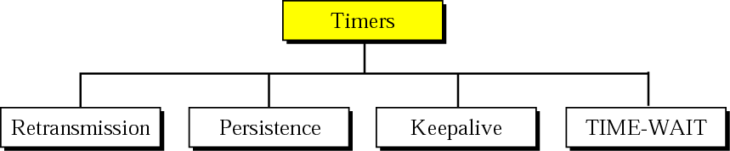
TCP Timers

Slide 61
TCP Timers cont.
Timer | Purpose
Retransmission | For error control
Persistence | To avoid problems of zero window size advertisement
Keep alive | To check whether client is alive if it is idle for a long time
Time- waited | To avoid problems with delayed FIN segments

Slide 62
Retransmission Timer
This timer starts after sending a segment
If the acknowledgement is not received before this timer expires, the same segment is re-transmitted and the timer is reset
If the acknowledgement is received before retransmission timer expires that timer will be destroyed (Timer will be stopped)

Slide 63
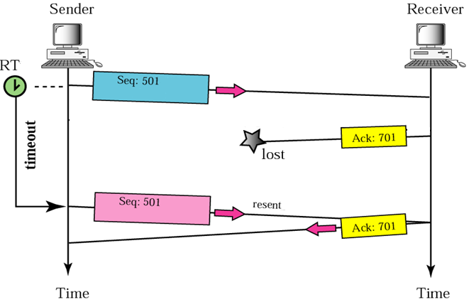
Retransmission Timer cont.
Retransmission time =2 x Round Trip Time

Slide 64
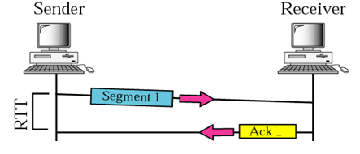
Round Trip Time
A
B
The time involved here are
Propagation delay from A to B
Processing time at B
Propagation delay from B to A
The total of above times are called Round Trip Time

Slide 65
Measured Round Trip Time
Can measure Round Trip Time Using the “time stamp” obtained from the option field of TCP header
TCP sends a segment, starts a timer, and waits for acknowledgement
It measures the time between sending of the segment and receiving of the acknowledgement

Slide 66
Setting the Round Trip Time
Setting RTT= α x Previous RoundTT+(1-α) Current RoundTT
α = 90%
Setting RTT= 0.9 x Previous RoundTT+ 0.1 Current RoundTT
There is a difference between measured Round Trip Time and setting Retransmission Time
Retransmission timer =2 x Setting RTT

Slide 67
RTT cont.
Segment | Measured RTT (ms) | Set RTT (ms) | Ret Timer
n | 250 | ---
n+1 | 200 | --- | 500
n+2 | 180 | 90%250+10%200 = 245 | 490
n+3 | 220 | 90%200+10%180 = 198 | 396

Slide 68
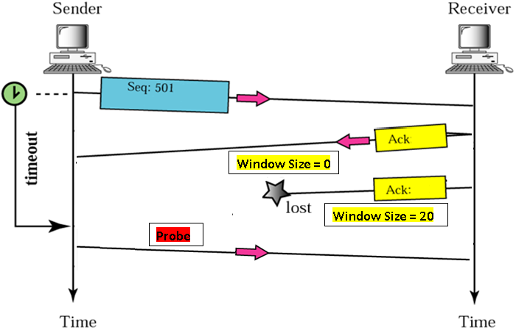
Persistence Timer
Timer set to the Ret.Timer Value
Timer Doubled and reset maxof 60Sec.
ThreshHold – 60 Sec

Slide 69
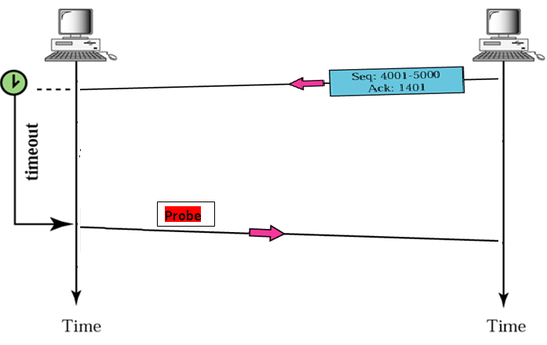
Keep alive Timer
2Hr
Max of 10 Probes in 75Sec interval

Slide 70
Time Waited Timer
Client
FIN
Server
ACK
FIN
FIN
ACK
TIME
SYN
SYN,ACK
ACK
FIN

Slide 71
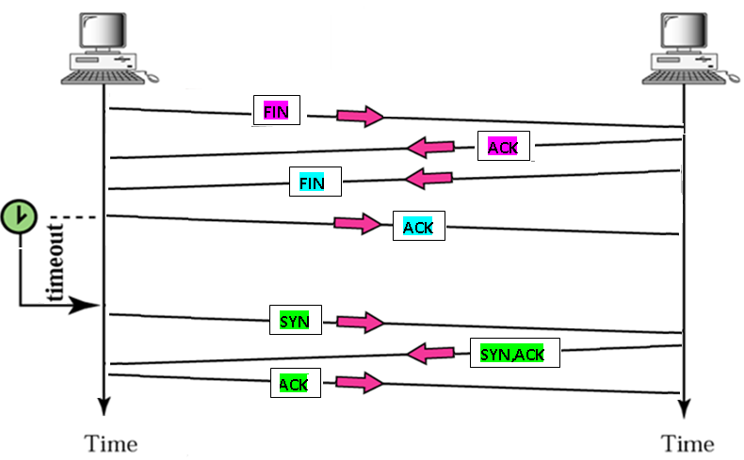
Time Waited Timer cont.
2 mins

Slide 72
Error Control
TCP uses the backward error control
For error detection, the checksum bits in the TCP header is used by the receiver
If the receiver detects errors, it will discard that segment
The receiver will not send any negative acknowledgement to sender

Slide 73
Error Control cont.
Error control process considers,
Errors in the received segment (corrupted segments)
Segment is lost on the way before reaching the receiver (last segment)
Duplicate received segments
Out of order segments (the segment numbers are not received in order)
Lost an acknowledgement on the way

Slide 74
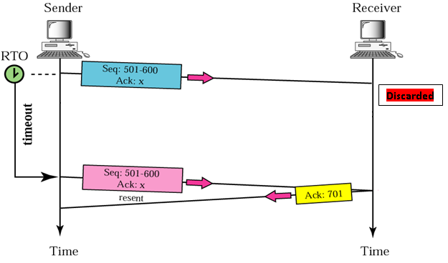
Corrupted Segment

Slide 75
Out of order segment
The IP packets can travel through different routers
Therefore the segments can reach the receiver TCP layer out of order
The TCP layer waits until previous segment(s) are received and then acknowledges

Slide 76
Duplicate segment
If IP packet travels through a long way the retransmission timer expire and sender retransmit the same segment
The receiver receives both segments
If the first segment received has no errors, it is accepted and acknowledged
The second segment is ignored by the TCP layer

Slide 77
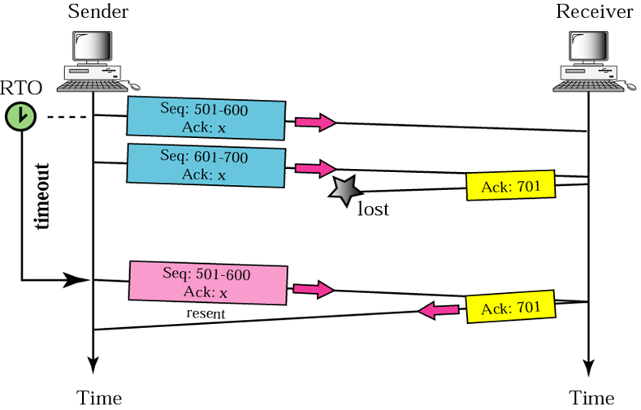
Lost acknowledgement

Slide 78
Window Size
Receiver TCP buffer can be overflowed due to two reasons
- The receiver TCP buffer receives data very fast
- The receiver application consumes data very slowly
Receiver TCP should inform the sender TCP how much bytes of data it can accommodate
It is called the window size

Slide 79
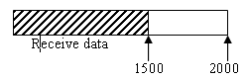
Windows Size cont.
Scenario 1 : Suppose the TCP buffer size is 2000 bytes
If it receives 1500 bytes of data, 500 bytes buffer space is free
Then it informs the sender the window size is 500

Slide 80
Windows Size cont.
Scenario 2 : Application may have consumed another 800 bytes,
The remaining data bytes in the buffer is
1500 – 800 = 700 bytes
New window size is
2000-700 = 1300

Slide 81
Windows Size cont.
Scenario 3 : Sender may send 500 bytes
The remaining data bytes in the buffer is
700 + 500 = 1200 bytes
New window size is
2000-1200 = 800
1200
2000

Slide 82
Windows Size cont.
Scenario 4 : Sender may send 800 bytes. But the receiver application was busy and it did not consume any data.
The remaining data bytes in the buffer is
1200 + 800 = 2000 bytes
New window size is
2000-2000 = 0
2000 bytes

Slide 83
Windows Size cont.
Scenario 5 : Receiver application consumed 200 bytes of data
The remaining data bytes in the buffer is
2000 - 200 = 1800 bytes
New window size is
2000-1800 = 200

Slide 84
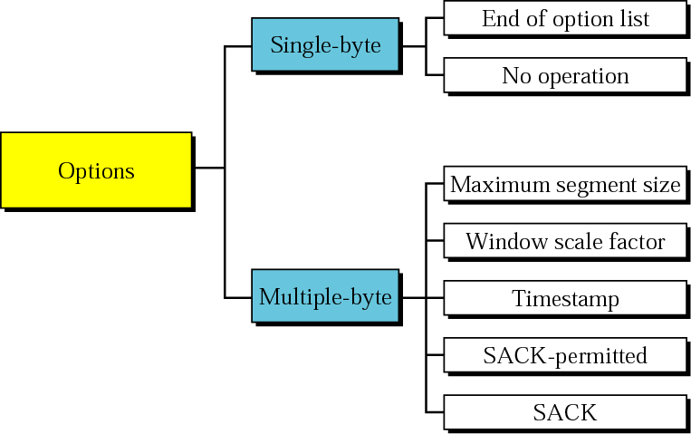
TCP Option

Slide 85
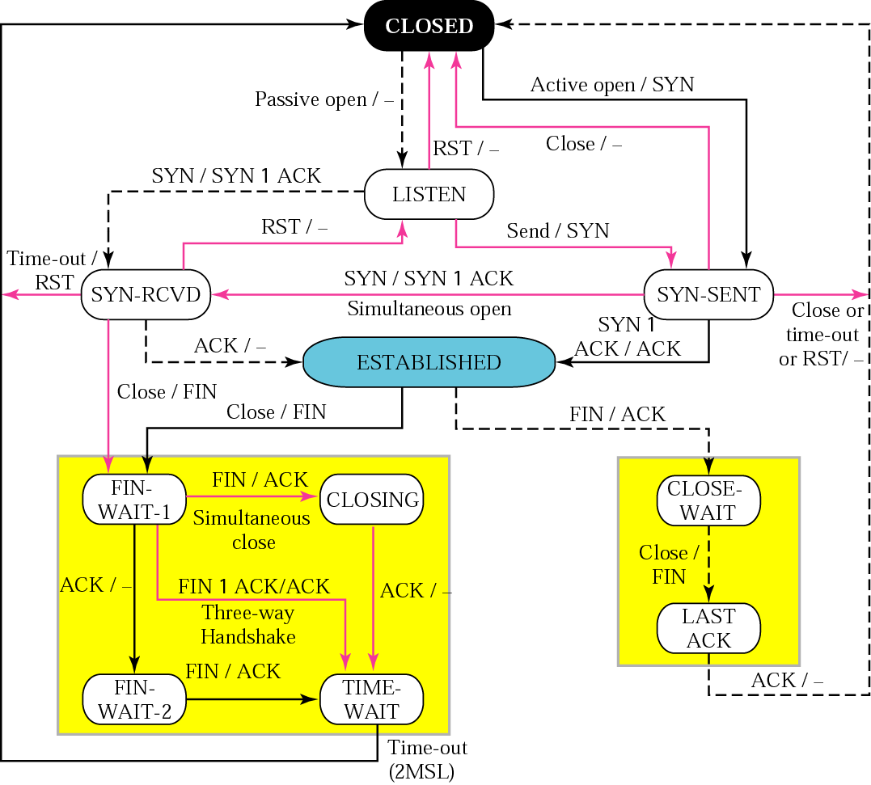
TCP state Transition Diagram

Slide 86

CLIENT
CLOSED
SERVER
Send: SYN
Recv: SYN
LISTEN
Send: SYN,ACK
SYN_SENT
SYN_RCVD
Recv: SYN,ACK
Recv: ACK
Send: ACK
ESTABLISHED
Recv: FIN
Send: FIN
CLOSE_WAIT
Send: ACK
FIN_WAIT_1
Send: FIN
Recv: ACK
Recv: ACK
LAST_ACK
2MSL timeout
Recv: FIN
FIN_WAIT_2
TIME_WAIT
Send: ACK

Slide 87
CLIENT
SERVER
CLOSED
CLOSED
LISTEN
SYN_SENT
SYN
SYN_RCVD
SYN,ACK
ESTABLISHED
ACK
ESTABLISHED
Data
ACK
FIN_WAIT_1
FIN
CLOSE_WAIT
FIN_WAIT_2
ACK
FIN
TIME_WAIT
ACK
CLOSED
CLOSED

Slide 88
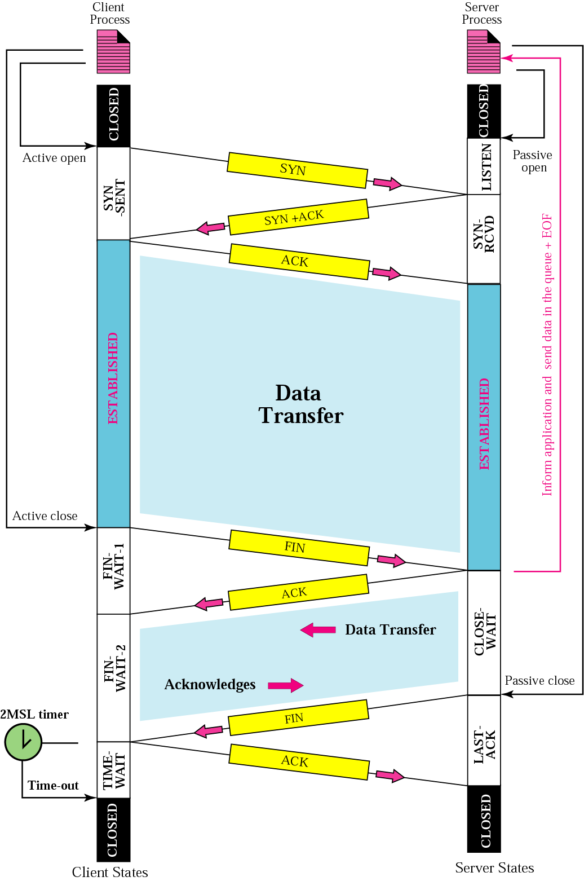

Slide 89
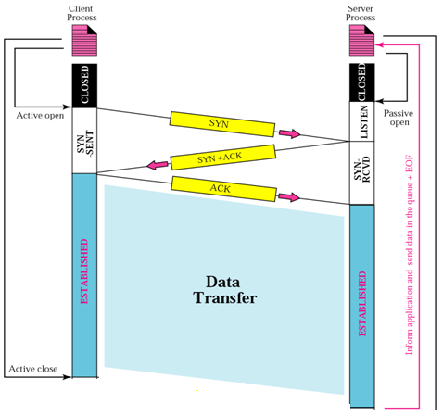

Slide 90
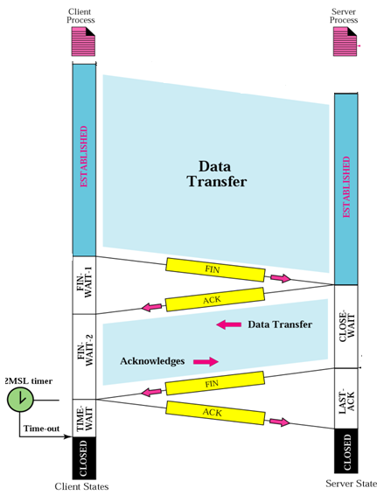

Slide 91
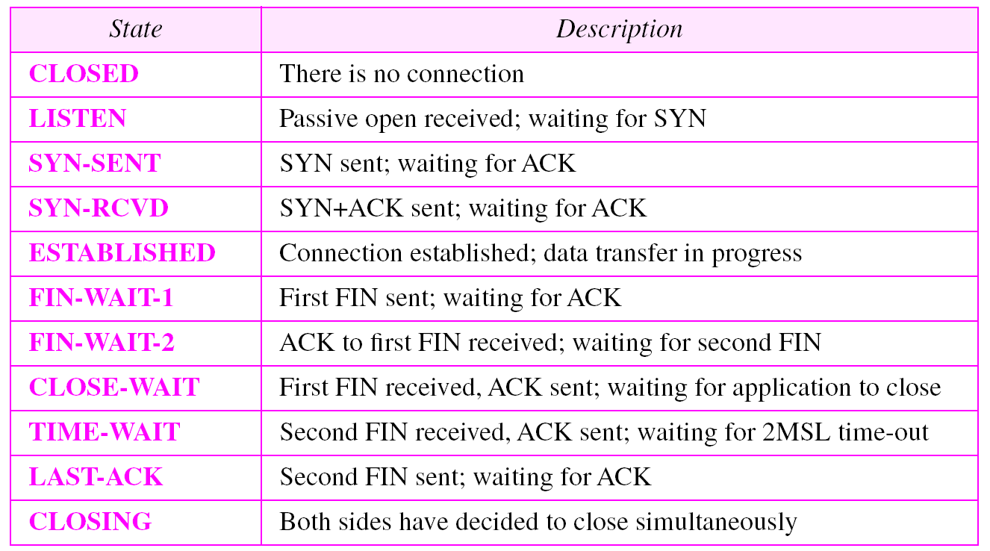

Slide 92
User Datagram Protocol (UDP)
The UDP operation is same as TCP with the following differences
UDP does not have a connection establishment process
UDP does not have a connection termination process
UDP does not have error control, flow control and congestion control mechanisms
UDP header has only 8 bytes

Slide 93
UDP cont.
Since UDP does not get any feedback from the receiver, there is no guarantee of delivering data to the receiver by UDP
Therefore UDP is an unreliable simple protocol
Because of its simplicity it is used for specific applications especially the broadcast type applications

Slide 94
UDP Port numbers
Port Number | Application
69 | TFTP
53 | DNS
161 | SNMP
520 | RIP

Slide 95
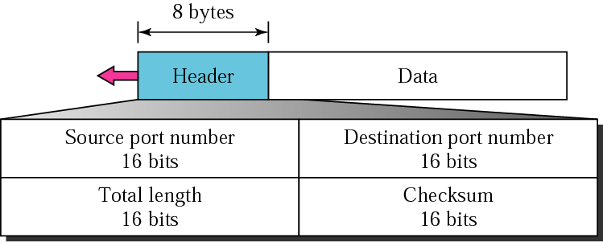
UDP Header

